Slide 1
bookly
midterm presentation

Slide 2

Outline
Project Management
Scrum and YouTrack
Burn-Down-Chart
RUP
Extend of functionality
Use Cases for Mockup
Architecture
Automation
Demo

Slide 3
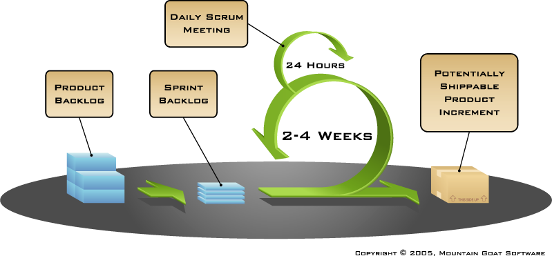
Scrum and Youtrack

Slide 4
RUP- Rational Unified Process
Alexandra
Requirements Specifier: Describe and phrase the features / design of the website with the team
Project Manager: Phrase acceptance criteria of the features + Coordinate sprints + Manage YouTrack + Assign Tags
Jeanne
Implementer: Create database structure, logic, and interfaces (API)
Tester: Test the interfaces (APIs) between Frontend, Backend and Database and the functionality of the Frontend
Nico
Deployer: Host domain and integrate CI (and Docker)
Designer: Implement the design described in the Use-Cases + Web tests

Slide 5
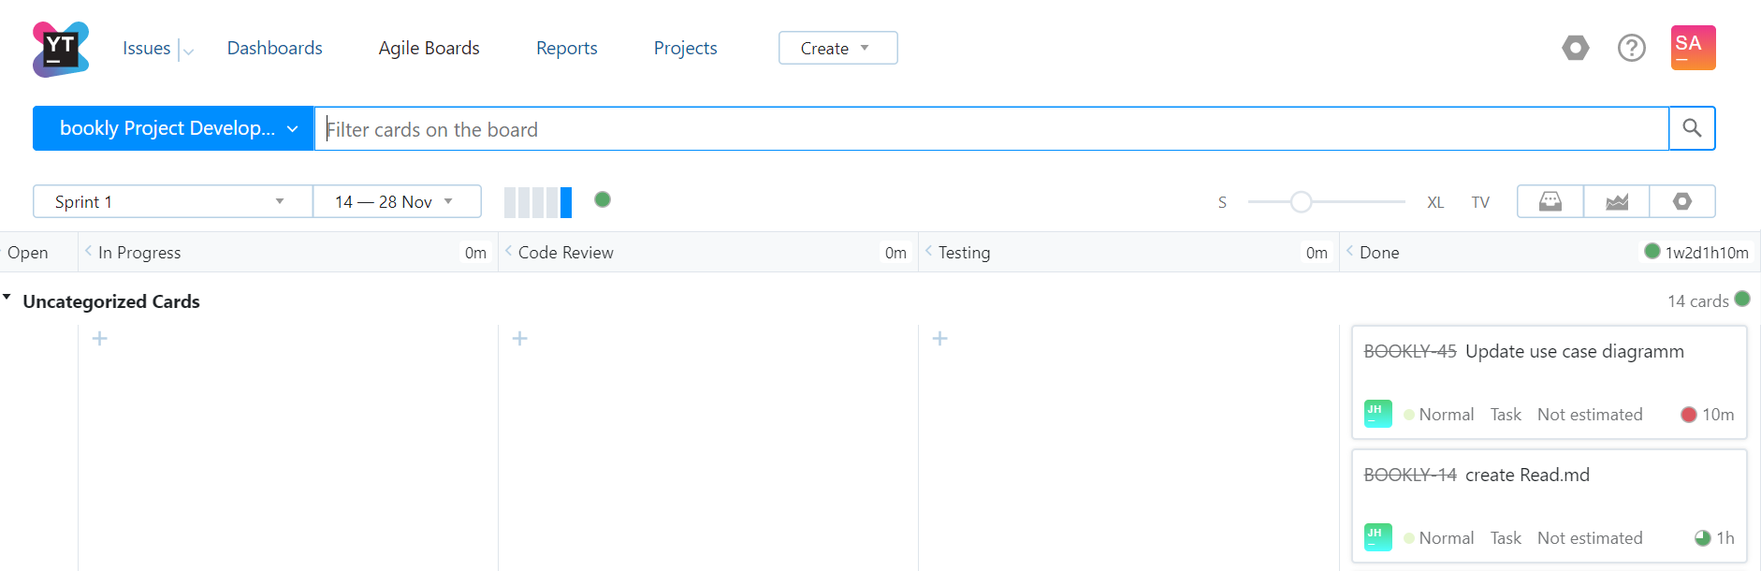
Scrum and Youtrack

Slide 6
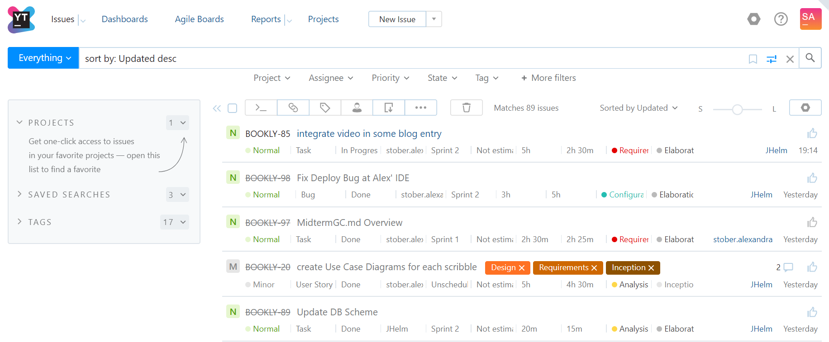
Scrum and Youtrack

Slide 7
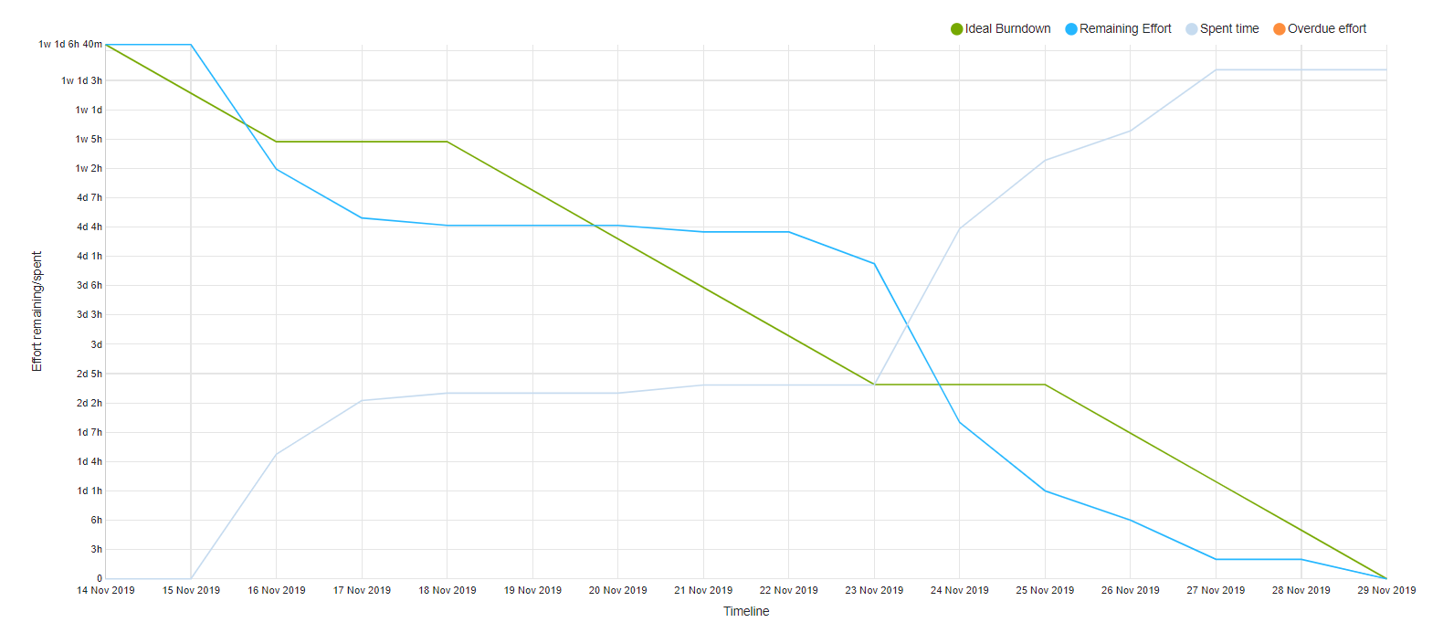
Burn-Down-Chart

Slide 8
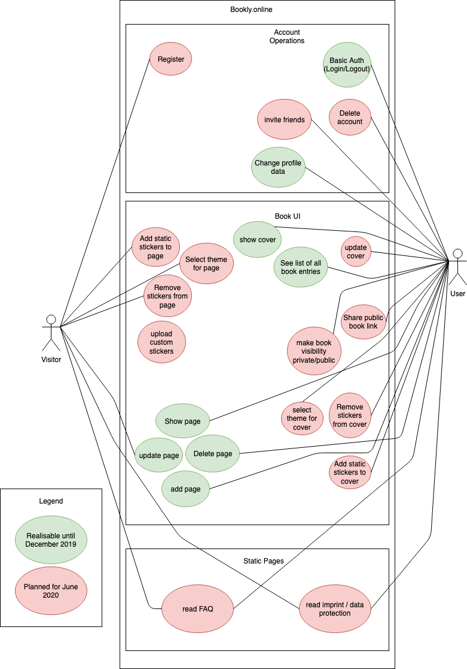
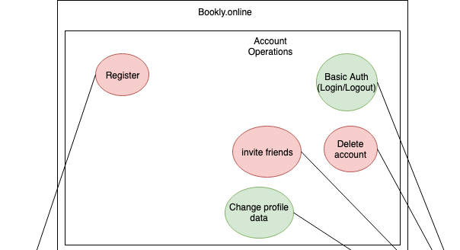
Extend of functionality

Slide 9
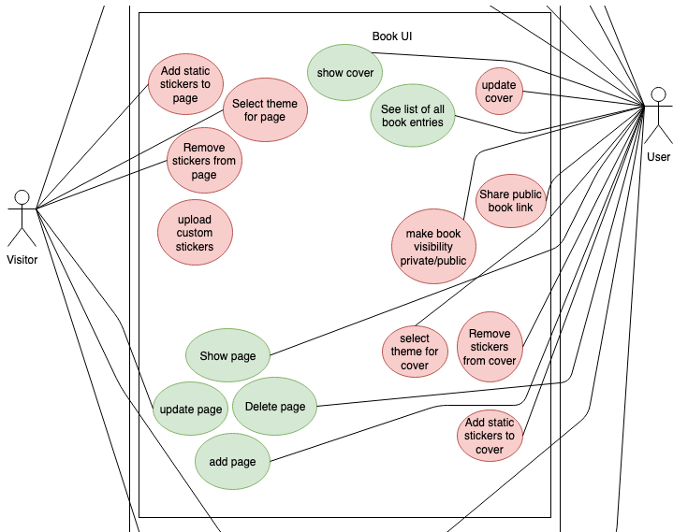
Extend of functionality

Slide 10
Use CaseS for Mockup
CRUD: Manage page:
C: create book entry - S E
R: read an entry - S E
U: update/edit an entry - S E
D: delete an entry - S I
CRUD: Manage Book:
C: create a book - S E
R: show all entries & cover - S E
U: update the cover - X I
D: delete the whole book - S I
Legend:
S=Scope; X = out of scope;
I = Included in CRUD (not counted as UC)
E = Excluded (external UC document -> counted as UC)

Slide 11
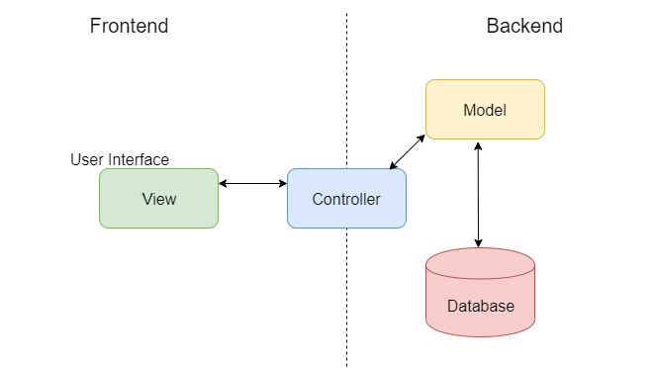
Architecture - Overview

Slide 12
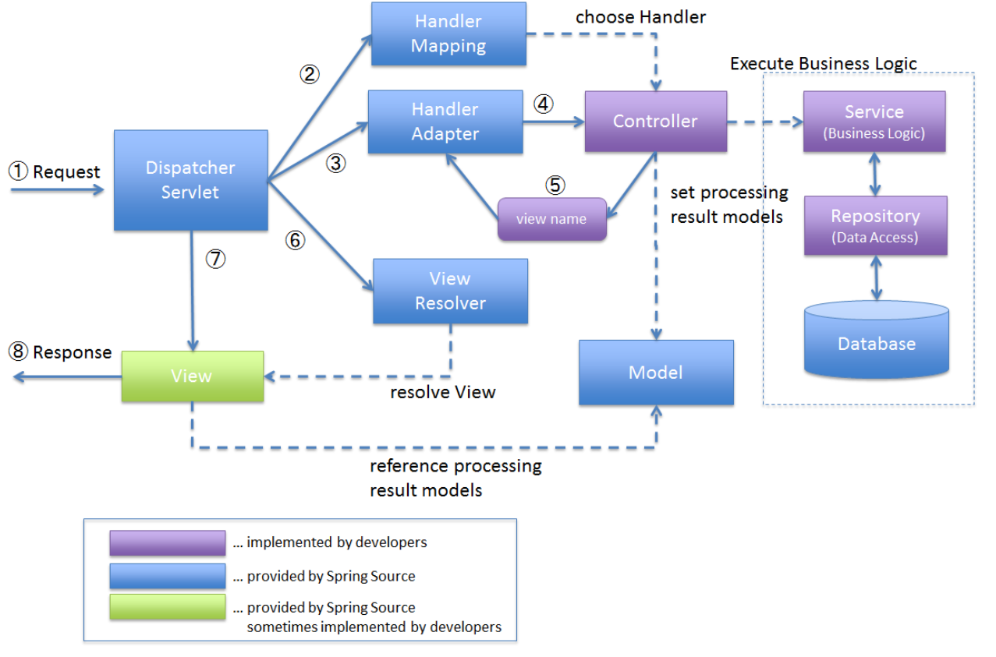
Architecture – Overview

Slide 13
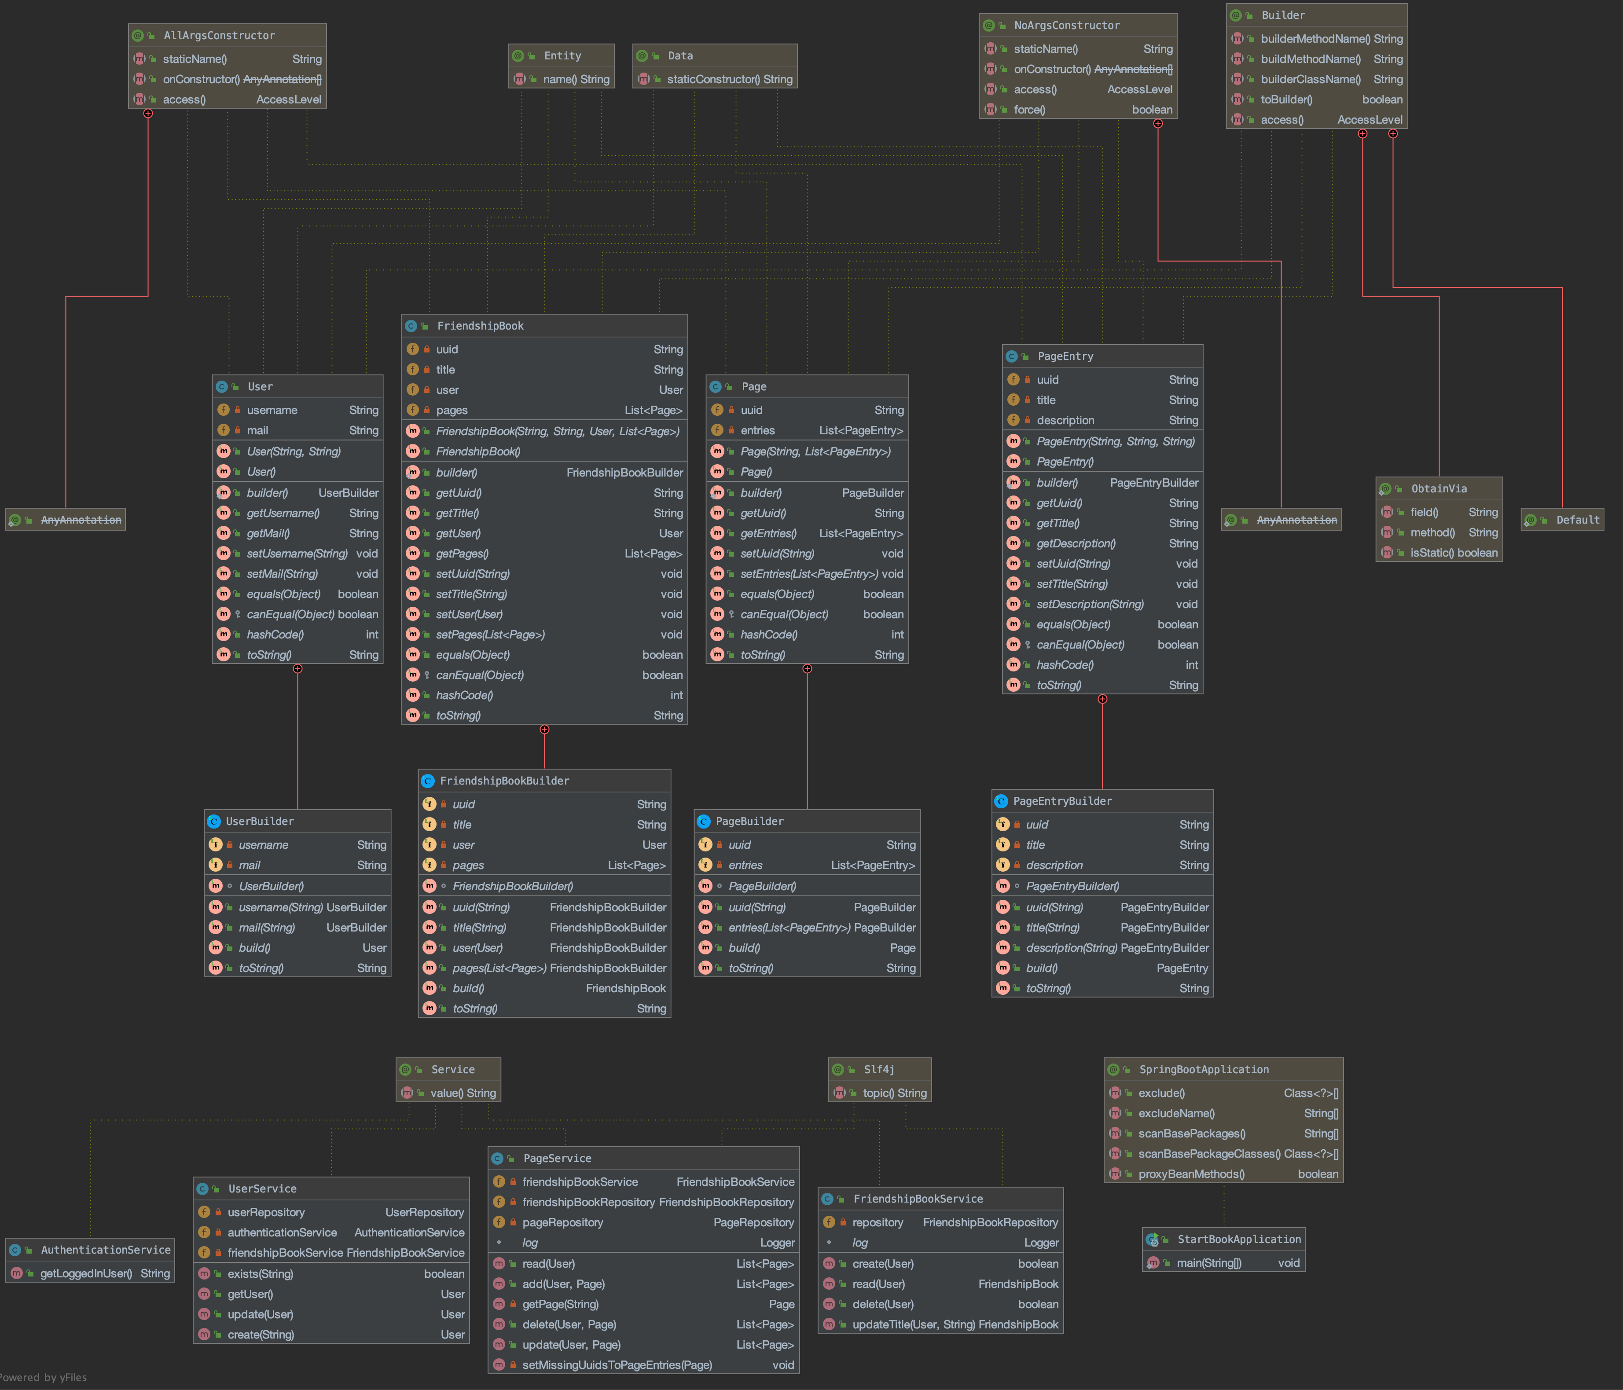
Class Diagram

Slide 14
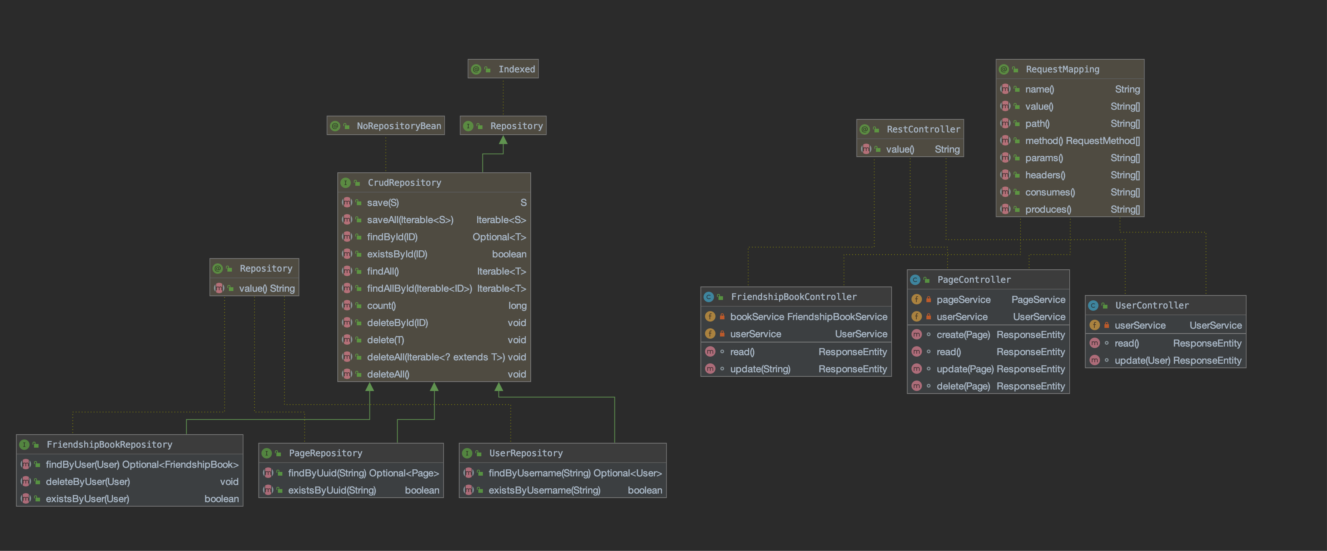
Class Diagram

Slide 15
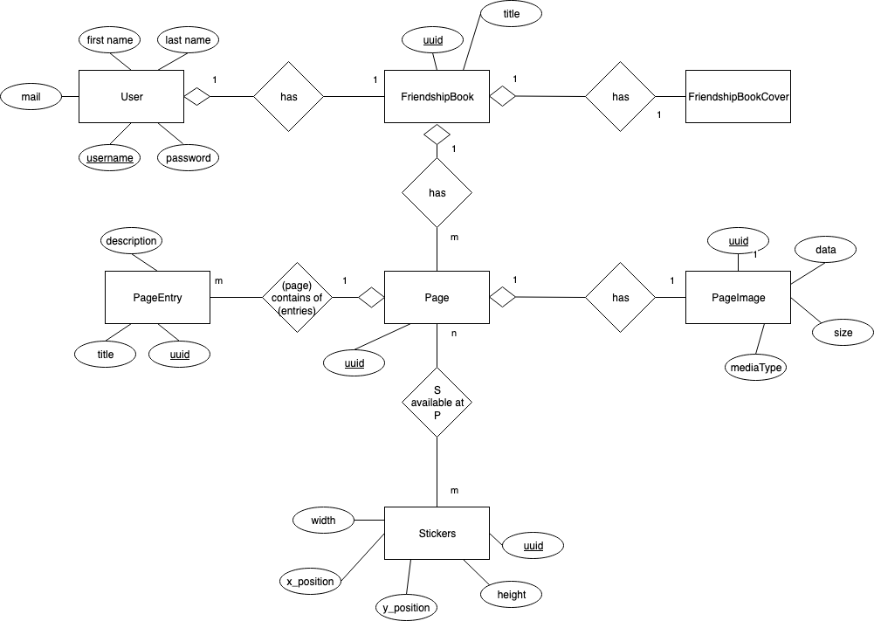
Architecture – Data View

Slide 16
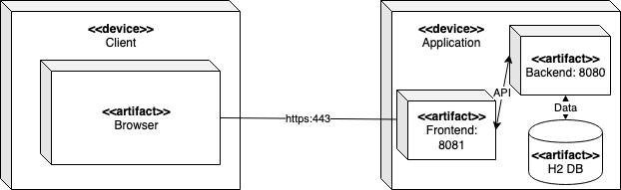
Architecture – Deployment View

Slide 17
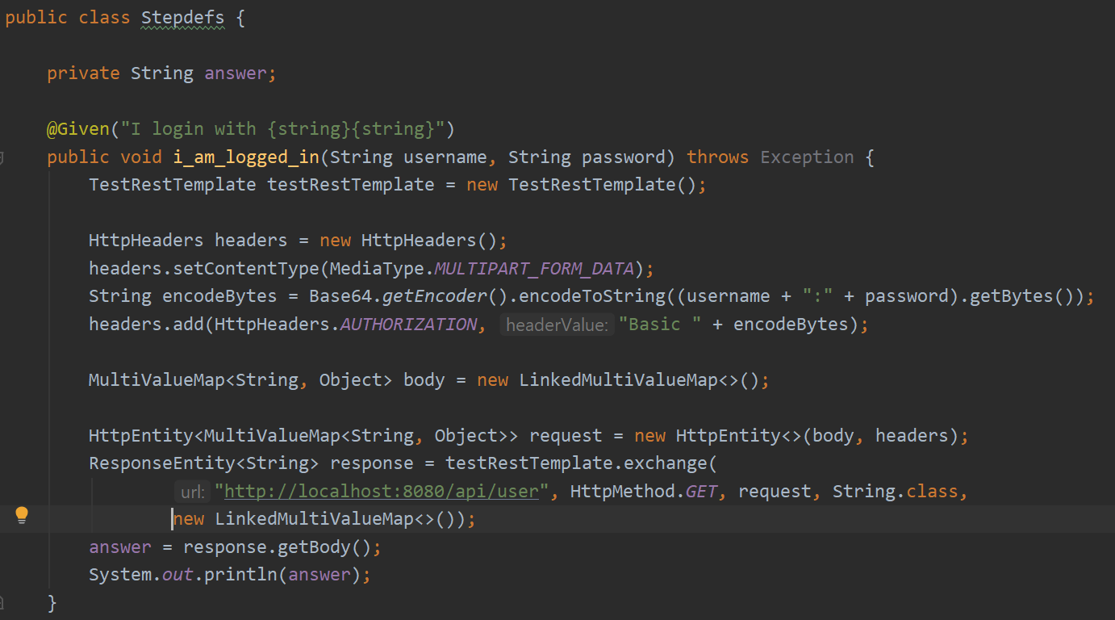
Automation
BDD tests with Cucumber are up and running

Slide 18
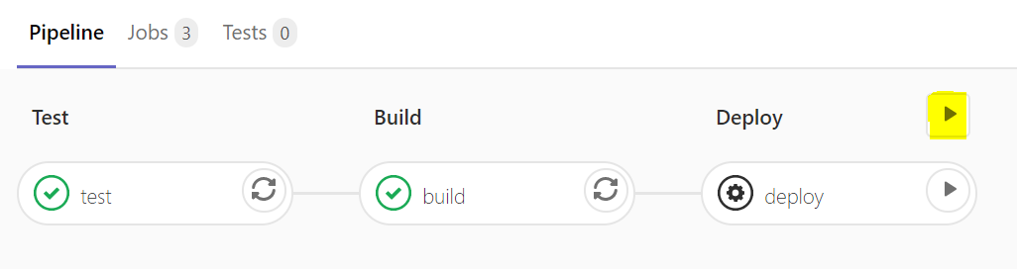
Automation
Pipeline: automatic Test -> Build -> Deploy with one click

Slide 19
DEMO
BOOKLY - friendship book

